Slide 1

HR Employees Details Dashboard
Doan Thi Van Khanh
Sep 7th 2024

Slide 2
1. Data Collection
Download dummy dataset from web training. Link
Load data to PBI by using Enter Data function.
2. Data Cleaning
Review and validate dataset for accuracy and completeness.
Implement data normalization techniques to ensure consistency and uniformity across all datasets
3. Data Visualization
Use PBI to generate interactive and insightful visual representations of HR metrics.
Identify and present key performance indicators related to employee satisfaction and other relevant HR insights.
Dashboard overview

Slide 3
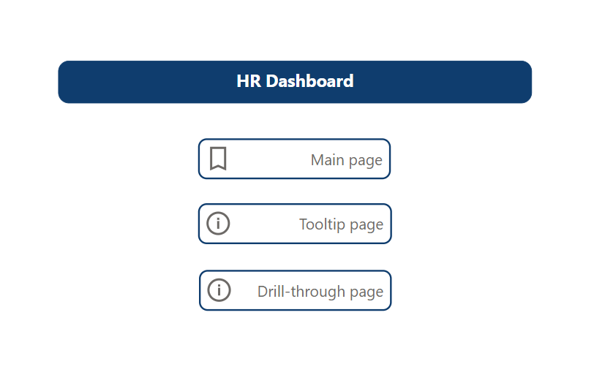
Dashboard overview : Concept page
The dashboard comprises three pages: main page, tooltip page, and drill-through page.
To navigate to a page, use the Ctrl+click function.

Slide 4
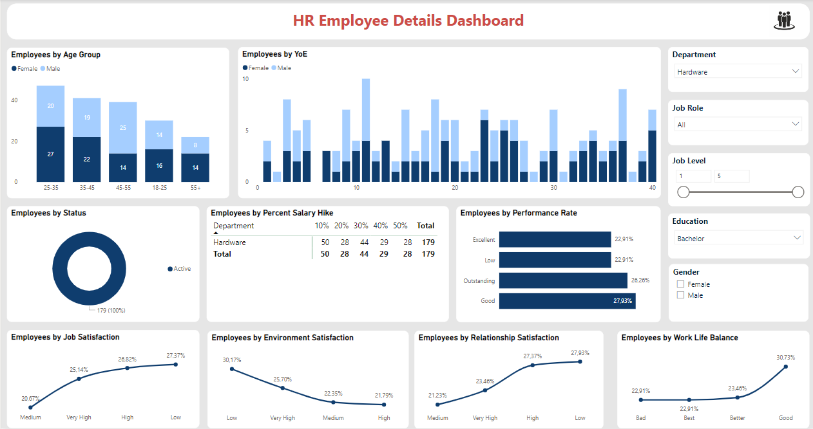
Main page overview

Slide 5
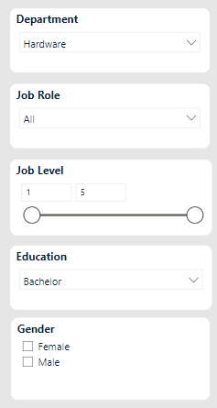
Main page : Filters
The dashboard provides 5 universal filtering categories for all charts and tables.
This includes 3 dropdown slicers for multiple selections, 1 option to choose all from a vertical list, and 1 range filter for job levels.
Can select multiple filters simultaneously using "ctrl + click" or apply all filters at once for added flexibility.

Slide 6
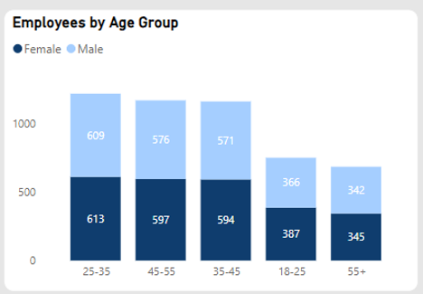
Main page: Stacked column chart : Employees by Age Group
The collective count of female employees stands at 2536, surpassing that of male employees, which stands at 2464.
Group 25-35 years old female employees constitute 1.62% of the entire workforce.
The average number of female employees, at 63.40, exceeds that of male employees, which averages at 61.60.
The most significant disparity in employee count between females and males was observed within the 35-45 age group, with females exceeding males by 23 employees.

Slide 7
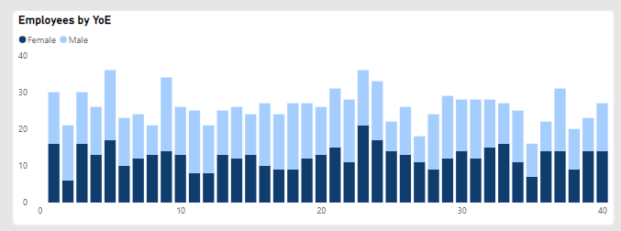
Main page: Line and Stacked column chart : Employees by YoE
This chart illustrates the distribution of employees based on their years of experience at work, segmented by gender.

Slide 8
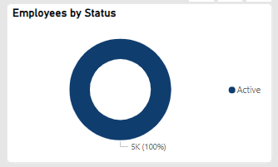
Main page: Donut chart : Employees by Status
This donut chart visualizes the distribution of employees based on their current status within the company. All employees, accounting for 100%, are currently active in their roles.

Slide 9
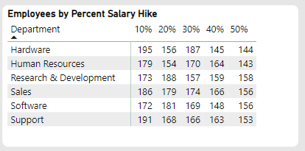
Main page: Matrix table : Employees by Percent Salary Hike
This table presents the distribution of employees based on the percentage of salary increase, categorized by department.

Slide 10
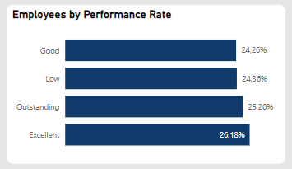
Main page: Stacked bar chart : Employees by Performance Rate
This chart presents the aggregated performance ratings of employees as measured by the tracked key performance indicators.
There is a significant prevalence of low performance, with approximately 25%, indicating the need for improvement.

Slide 11
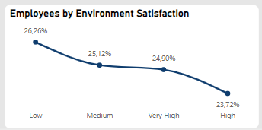
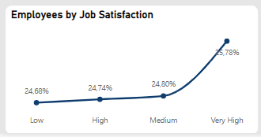
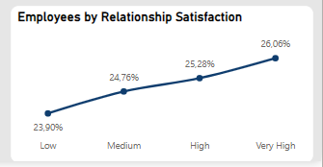
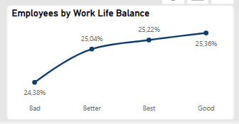
Main page: Line chart : Employees by Satisfaction
These line charts depict the employee satisfaction indicators.
Overall, most employees are dissatisfied with the work environment but highly satisfied with their job and internal relationships within the company.
However, the work-life balance indicator reveals an overall unfavorable rating, as the variance between poor scores and other ratings is minimal.
Variance is ~ 0.325%

Slide 12
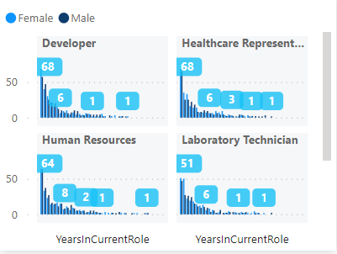
Tooltip page : Years in current role details by department and gender
To conduct a comprehensive analysis of employee data, examine the columns and numerical values that indicate the employee count.
This tooltip offers insights into specific employee details, including department, tenure in current role, and gender. Simply hover over the column or chart to view the tooltip.

Slide 13
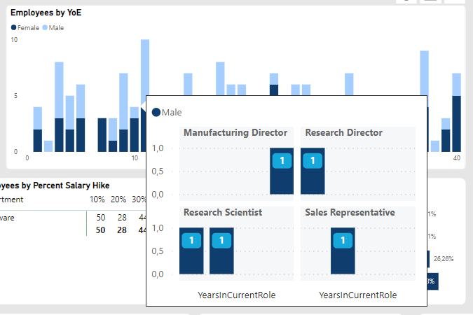
Tooltip page : Years in current role details by department and gender
Hover to this column
The tooltip displays comprehensive information about employees in groups of 10 years of experience (YoE). There are 4 departments, each with 1 male employee in every 10-year experience group. The years of experience in the current job is 1 year for all employees.

Slide 14
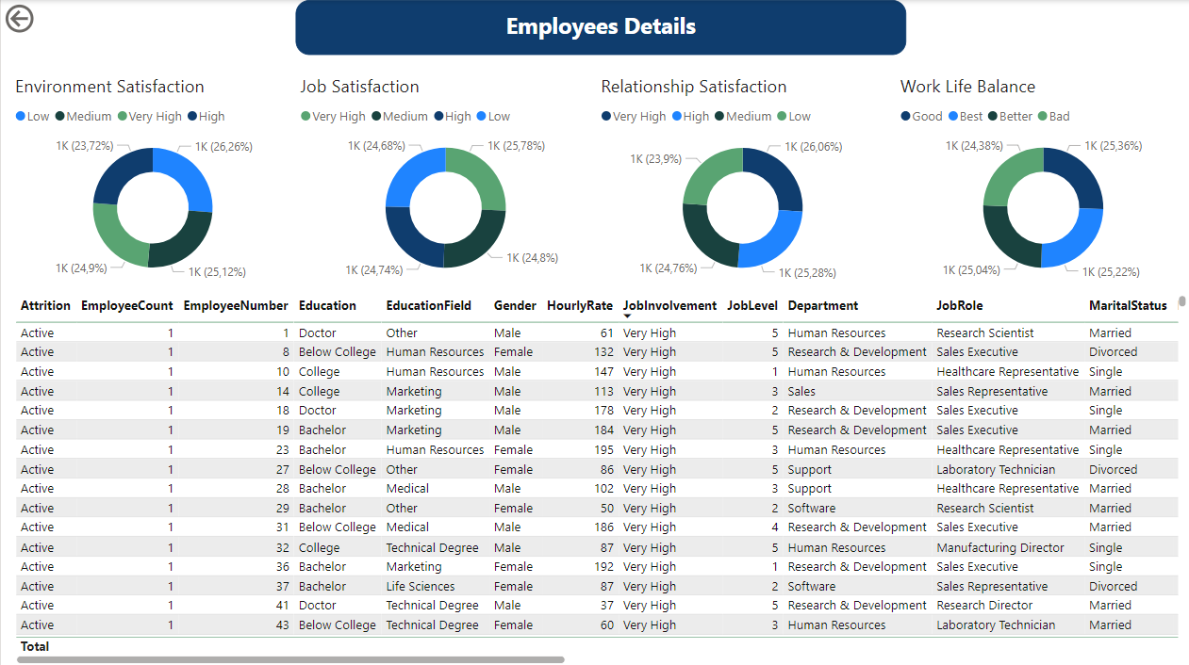
Drill-through page : Employees details

Slide 15
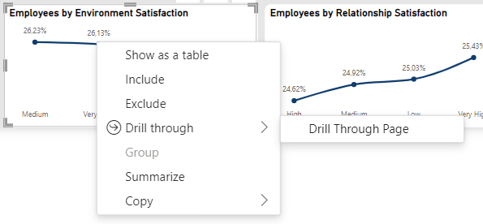
Drill-through page : Employees details
Right-click in a data point to access the drill-through function.
This feature allows users to delve deeper into all charts and tables on the main page to access detailed information on the selected item.

Slide 16
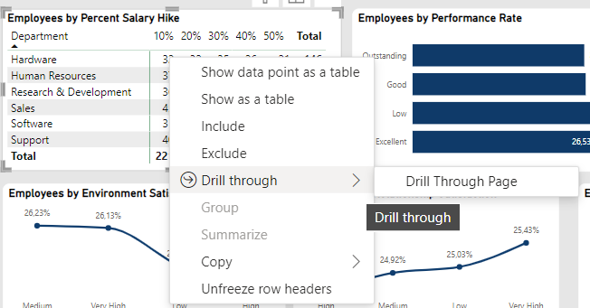
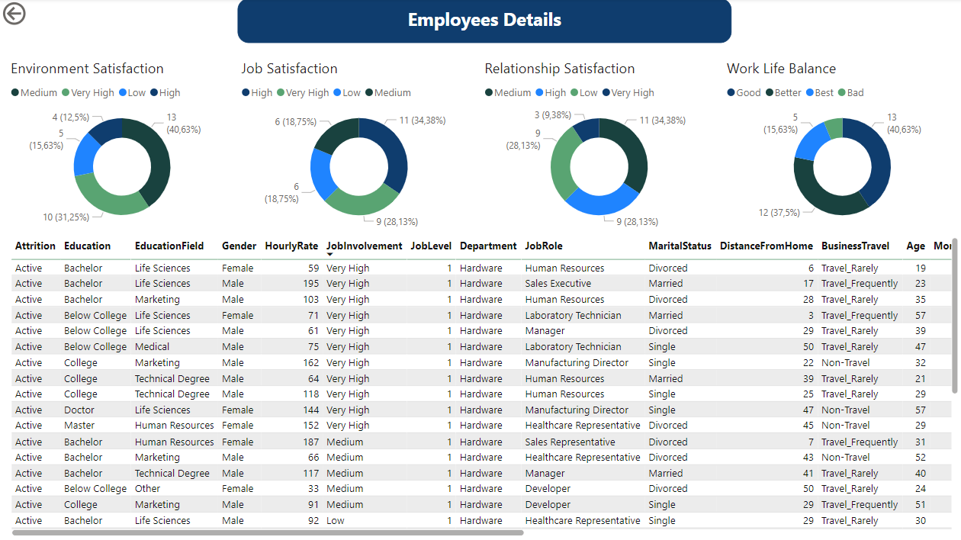
Drill-through page : Employees details
Following the drill-through action, drill-through page will be filtered based on the information of the data point that is right-clicked on the main page.
Drill-through page after being applied

